Slide 1
Downtown Stockton Development
Project Considerations

Slide 2
DUE DILLIGENCE
Floodplain regulations
Fees
Fire & Life Safety
Structural / Seismic Upgrades
Neighborhood services
Accessibility (ADA)
zoning

Slide 3
General Plan Policies – Strengthen and Promote the Downtown
Commercial, Downtown Zoning District
Mixed Uses By-Right
Apply historic preservation guidelines, as applicable
Densities 136 units/ net acre
No Height Limit
Staff-level Site Plan/Design Review

Slide 4
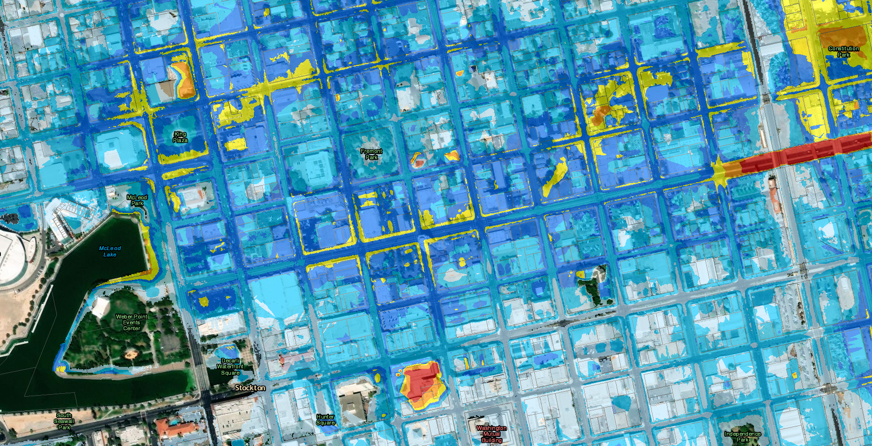
FLOODPLAIN REGULATIONS
200-YEAR FLOOD MAP OF DOWNTOWN
SENATE BILL 5 (SB 5)
Effective in July 2016
Applies to all new residential dwelling units, including new dwelling units in existing buildings
Applies to non-residential projects that require discretionary review (i.e. use permit)
Requires elevation or floodproofing in some cases – doesn’t effect most of downtown
BLUE = NO BUILDING RESTRICTIONS
YELLOW / ORANGE / RED = POSSIBLE BUILDING RESTRICTIONS, FURTHER REVIEW REQUIRED

Slide 5
FIRE & LIFE SAFETY
DOES THE BUILDING HAVE PROPER EXITING?
exit stairs vs. fire escapes
DOES THE BUILDING HAVE A COMPLETE FIRE SPRINKLER / FIRE ALARM SYSTEM?
Required for most projects, check with City of Stockton Fire Dept
EMERGENCY ESCAPE WINDOWS REQUIRED IN ALL SLEEPING AREAS
EVALUATE THE PROJECT FOR FIRE RATED CONSTRUCTION REQUIREMENTS

Slide 6
STRUCTURAL / SEISMIC UPGRADES
STOCKTON IS LOCATED IN SEISMIC DESIGN CATEGORY D FOR THE PURPOSES OF CODE COMPLIANCE
IS THE BUILDING CONSTRUCTED OF UNREINFORCED MASONRY (URM)?
ANY ALTERATIONS TO THE VERTICAL OR LATERAL LOAD RESISTING SYSTEMS OF THE BUILDING?

Slide 7
STRUCTURAL / SEISMIC UPGRADES
2019 CALIFORNIA CODE REQUIREMENTS
(effective Jan 1, 2020)
Increase in vertical loading (5%) or lateral loading (10%) requires upgrades to current codes
Projects that include a substantial structural alteration requires full code compliance for the lateral load resisting system
Alterations exceeding 50% of the building area trigger structural upgrades
Bracing for unreinforced masonry bearing walls
Bracing for unreinforced masonry parapets
Anchorage of unreinforced masonry partitions

Slide 8
ACCESSIBILITY (ADA)
PRIVATELY FUNDED
(no federal, state, local funding, including grants, loans, programs, tax credits)
CONSTRUCTED PRIOR TO
MARCH 13, 1991
(for any use)
NO OBLIGATION TO PROVIDE ACCESSIBLE FEATURES EXCEPT PUBLIC AREAS
(i.e. leasing office)
PUBLICLY FUNDED
(any type of federal, state, or local assistance)
COMPLY WITH CBC CHAPTER 11A & 11B
(city review)
COMPLY WITH OTHER STANDARDS AS REQ’D BY FUNDING SOURCE
(developer / architect responsibility)

Slide 9
FEES
BUILDING PERMIT / PLAN CHECK FEES ARE CALCULATED BASED ON THE PROJECT VALUATION
ADDITIONAL FEES MAY BE REQUIRED FROM OTHER AGENCIES SUCH AS THE SCHOOL DISTRICT
PUBLIC FACILITY FEES (IMPACT FEES) MAY BE APPLICABLE IF NEW SQUARE FOOTAGE OR CHANGE OF USE
SOME PFFs WAIVED FOR DOWNTOWN RESIDENTIAL PROJECTS, CREDITS AVAILABLE FOR DEMOLISHED BLDGS

Slide 10
ECONOMIC DEVELOPMENT INCENTIVE PROGRAMS
GREATER DOWNTOWN STOCKTON RESIDENTIAL DEVELOPMENT PUBLIC FACILITIES FEE EXEMPTION PROGRAM
Fee waiver for certain Public Facilities Fees (PFF) for housing developments located in the Greater Downtown District or the area bounded by Harding Way, Wilson Way, Dr. Martin Luther King Jr. Boulevard/Charter Way, and Pershing Avenue
No application needed
Waiver applied at issuance of building permit
Expires December 31, 2020

Slide 11
ECONOMIC DEVELOPMENT INCENTIVE PROGRAMS
GREATER DOWNTOWN STOCKTON RESIDENTIAL DEVELOPMENT PUBLIC FACILITIES FEE EXEMPTION PROGRAM
City Public Facilities Fees
Air Quality
City Office Space
Community Recreation
Fire Station
Library
Parkland
Police Station
Street Improvement
Traffic Signals
Surface Water

Slide 12
ECONOMIC DEVELOPMENT INCENTIVE PROGRAMS
DOWNTOWN FINANCIAL INCENTIVE PROGRAM
Reimbursement for certain building permit fees and PFFs for eligible tenant improvements/rehabilitation projects located in the Downtown Stockton Business Assessment District
Residential or commercial buildings are eligible
Structure must have been continuously vacant for six (6) months or longer
Fees associated with building expansions or new construction are not eligible

Slide 13
ECONOMIC DEVELOPMENT INCENTIVE PROGRAMS
DOWNTOWN FINANCIAL INCENTIVE PROGRAM
City Public Facilities Fees
Air Quality
City Office Space
Community Recreation
Fire Station
Library
Parkland
Police Station
Street Improvement
Traffic Signals
Surface Water
In addition to sewer connection and administration fees; as well as certain building, fire protection, and public works fees are eligible.

Slide 14
ECONOMIC DEVELOPMENT INCENTIVE PROGRAMS
DOWNTOWN INFRASTRUCTURE INFILL INCENTIVE PROGRAM
Reimbursement for public infrastructure improvements related to the development of new market-rate residential, commercial, or mixed-used projects
Development must include:
Minimum of 35 new market-rate residential units and/or develop a minimum of 30,000 square feet of new, or newly renovated retail or commercial space
Capital investment of at least $500,000
Public infrastructure improvements of at least $100,000
Be located within the area bounded by Center Street, Park Street, ACE Rail/Union Pacific Railroad, and Washington Street
Examples of eligible public infrastructure improvements:
Sewer, water, and storm drain
Street improvements, including crosswalks, bike lanes, striping, medians
Traffic signals and streetlights
Landscaping

Slide 15
ECONOMIC DEVELOPMENT INCENTIVE PROGRAMS
COMMERCIAL FAÇADE IMPROVEMENT FORGIVABLE LOAN PROGRAM
Forgivable loan for commercial property owners making exterior cosmetic improvements to their property
COMMERCIAL LIEN FORGIVENESS INCENTIVE PROGRAM
Forgiveness for certain liens imposed on commercial property by the City for property owners facilitating substantial improvements and blight abatement
Applicant must demonstrate financial need
Applicant cannot have been the cause of, maintained, or allowed the violations, fines, fees or liens
Eligible properties can receive up to $20,000 per 50 linear feet of building street frontage, with a maximum of $100,000
Must be located within eligible area
COMMERCIAL EMERGENCY GRANT PROGRAM
Grant funding of up to $7,500 to alleviate existing code violations where the health or safety of the properties occupants is endangered
Must demonstrate financial need
Requires a dollar-for-dollar matching component from the property owner
City will provide up to $2,500 for architectural services
Liens must exceed $5,000

Slide 16
ECONOMIC DEVELOPMENT INCENTIVE PROGRAMS
COMMERCIAL FAÇADE IMPROVEMENT FORGIVABLE LOAN PROGRAM
Exterior cosmetic improvements
COMMERCIAL LIEN FORGIVENESS INCENTIVE PROGRAM
Liens must exceed $5,000 in soft costs
COMMERCIAL EMERGENCY GRANT PROGRAM
Up to $7,500 to alleviate code violations
Forgivable after five years; % each year
Must demonstrate financial need
Deed of Trust will be recorded; 5-yr monitoring

Slide 17
NEIGHBORHOOD SERVICES
PROPERTY PURCHASES AND LIENS
Liens prior to purchase, transfer to buyer unless cleared before sale.
Liens after purchase will remain until all issues are resolved.
Liens can be removed, through a stipulation agreement, consult NSS officer for detail
Once all issues are resolved, submit release request : www.Payoffdemand@stocktonca.gov.
Pay offs are processed in the order they are received
PROPERTY MAINTENANCE AND SECURITY
Post property with local contact number, that can be reached 24HR. City agencies will call it first.​
Submit "No Trespass" letter and post property. PD can then cite trespassers​
Take advantage of the free City service for removing graffiti. City will remove tags that do not require a ladder to reach or provide paint.
ALL NOTICES OF VIOLATION ARE SUBJECT TO PLANNING & BUILDING REQUIRMENTS

Slide 18
OTHER CONSIDERATIONS
CONSULT WITH AN EXPIERENCED ARCHITECT FAMILIAR OLDER / HISTORIC STRUCTURES
REVIEW THE CALIFORNIA HISTORICAL BUILDING CODE FOR APPLICABILITY TO THE STRUCTURE / PROJECT
(Provides relief from some current code requirements)
SCHEDULE A PRE-APPLICATION MEETING WITH THE CITY OF STOCKTON ECONOMIC DEVELOPMENT DEPARTMENT
REQUEST A FEE ESTIMATE FROM THE CITY OF STOCKTON COMMUNITY DEVELOPMENT DEPARTMENT

Slide 19
PROCESS OVERVIEW

Slide 20
Questions?
PLANNING DEPARTMENT – 209.937.8266
BUILDING DEPARTMENT - 209.937.8561
ECONOMIC DEVELOPMENT – 209.937.8539
NEIGHBORHOOD SERVICES – 209.937.8813
MUNICIPAL UTILITIES – 209.937.8436
FIRE PREVENTION – 209.937.8271

