Slide 1
THE LIVE/WORK opportunity

Slide 2
BLUEPRINT
PROBLEM
LIVE/WORK OPPORTUNITY
LIVE/WORK DEFINED
LIVE/WORK DEV. PROCESS
TIPS
HELPFUL CONTACTS
Notes:
Abundance of office space in downtown.
Vancancies.

Slide 3
PROBLEM: OFFICE SPACE
(-$$$$)
Notes:
Abundance of office space in downtown.
Vancancies.

Slide 4
OPPORTUNITY: LIVE/WORK SPACE
$$$
Notes:
$$$ - it will bring people to live downtown which will create the opportunity for more dollars to be spent here. Additionally, the work part will bring more dollars downtown

Slide 5
WHAT IS LIVE/WORK?
WORK
LIVE
Dual-purpose residential/work building where artists/other professionals both live and work
MAX 3,000 sqft./unit
MAX of 50% (MAX 1,500 sqft) can be non-residential

Slide 6
WHO CAN USE LIVE/WORK?
For renters OR owners
For artists, crafts-persons, self-employed consultants, small cottage industries
TIP! For live/work spaces, businesses do not need to acquire a home occupation permit

Slide 7
WHO CAN USE LIVE/WORK?
Can be self-employed OR people living and working as a group

Slide 8
HOW IS LIVE/WORK USED?
Shared workspace and/or equipment related to their activities
OR
Individually-owned equipment
inside their private living quarters

Slide 9
WHERE IS LIVE/WORK ALLOWED?
Allowed in the following zones:
Commercial Office (CO)
Commercial Neighborhood (CN)
Commercial General (CG)
Commercial Downtown (CD)
Light/Limited Industrial (IL)
Check City of Stockton’s Landmaster site to determine your zone
TIP! Allowed on 1st, 2nd, and 3rd floors without a Use Permit
Notes:
Red = Commercial Downtown
Blue = General Industrial
Light Blue = Light/Limited Industrial
Green = Public Facilities
Brown = High-Density Residential
Tan = Commercial Office
Purple Brown = General Commercial
Residential is a “By Right” use.

Slide 10
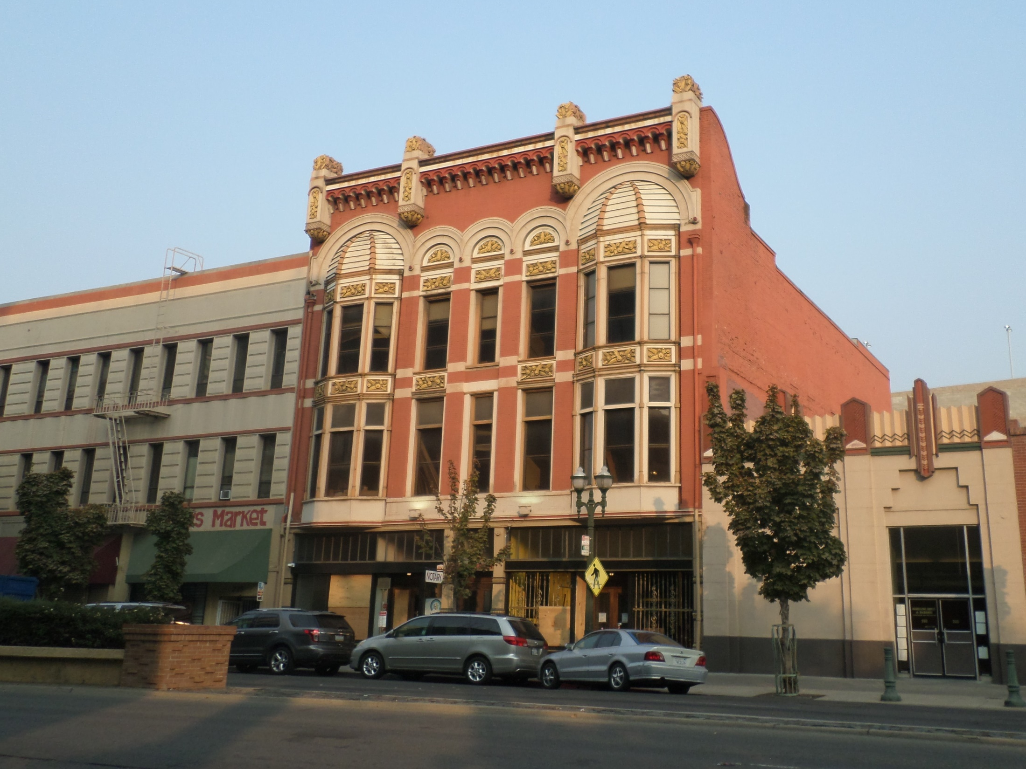
231 E. Weber
Notes:
Spaces coming soon!

Slide 11
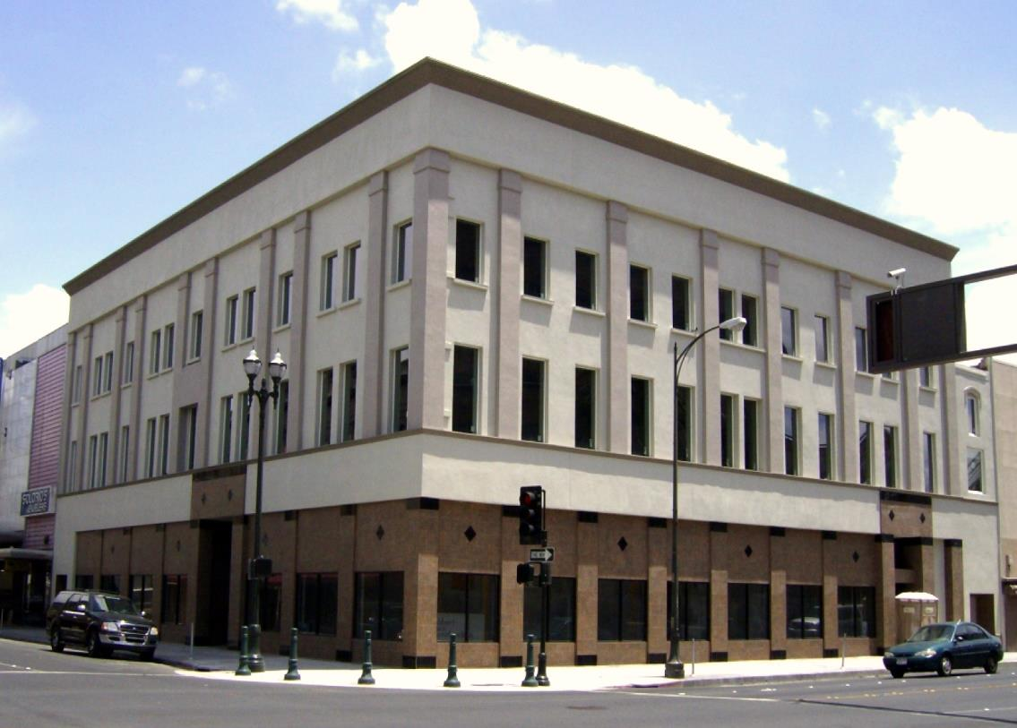
500 E. Main

Slide 12
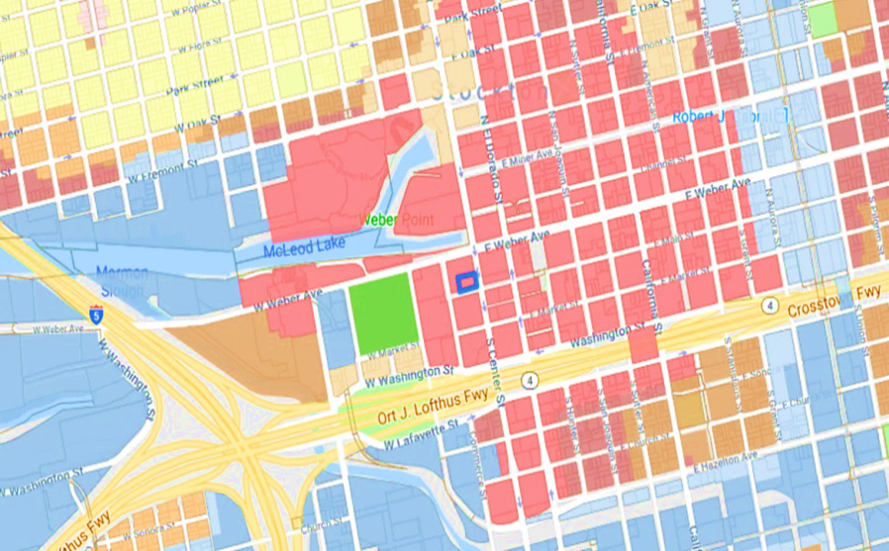
HOW DO I GET STARTED?
1
2
3
4
5
6
7
8
Contact planning to:
Determine that LIVE/WORK is allowed in your zone
Determine permit req. changes
3. Complete Building Permit App.*
SJ Air Pollution Control District Compliance Questionnaire
Environmental Health Hazardous Materials Disclosure
Non-residential Accessibility Upgrade Requirements
X 4
X 1
X 5
OR
2. Schedule an optional Economic Review Committee (ERC) meeting
Notes:
Red = Commercial Downtown
Blue = General Industrial
Light Blue = Light/Limited Industrial
Green = Public Facilities
Brown = High-Density Residential
Tan = Office Commercial
Darker Brown = General Commercial
NOT REQUIRED –
FEMA Flood and COS 200 year flood (unless new build)
Truss layout (unless modifying the roof)
Non-residential space must be on the main floor
No more than 5 non-residential workers can be in the non-residential space at one time
There must be accessible restrooms/plumbing for the non-residential area
Live/work spaces must be equipped with fire sprinklers and fire alarms
There must be adequate fire separation between each live/work unit
http://www.stocktongov.com/files/RequirementsPriorBuildingPermit.pdf

Slide 13
HOW DO I GET STARTED?
1
4
1
2
3
5
6
7
8
4. Receive feedback from city deps. (20 – 45 days)
5. Begin construction/
renovations
6. Vet potential tenants
Notes:
Red = Commercial Downtown
Blue = General Industrial
Light Blue = Light/Limited Industrial
Green = Public Facilities
Brown = High-Density Residential
Tan = Office Commercial
Darker Brown = General Commercial
NOT REQUIRED –
FEMA Flood and COS 200 year flood (unless new build)
Truss layout (unless modifying the roof)
Non-residential space must be on the main floor
No more than 5 non-residential workers can be in the non-residential space at one time
There must be accessible restrooms/plumbing for the non-residential area
Live/work spaces must be equipped with fire sprinklers and fire alarms
There must be adequate fire separation between each live/work unit
http://www.stocktongov.com/files/RequirementsPriorBuildingPermit.pdf

Slide 14
HOW DO I GET STARTED?
1
4
1
1
2
3
5
6
7
8
7. Pass final inspection
8. Begin leasing!
Notes:
Red = Commercial Downtown
Blue = General Industrial
Light Blue = Light/Limited Industrial
Green = Public Facilities
Brown = High-Density Residential
Tan = Office Commercial
Darker Brown = General Commercial
NOT REQUIRED –
FEMA Flood and COS 200 year flood (unless new build)
Truss layout (unless modifying the roof)
Non-residential space must be on the main floor
No more than 5 non-residential workers can be in the non-residential space at one time
There must be accessible restrooms/plumbing for the non-residential area
Live/work spaces must be equipped with fire sprinklers and fire alarms
There must be adequate fire separation between each live/work unit
http://www.stocktongov.com/files/RequirementsPriorBuildingPermit.pdf

Slide 15
TIPS! BUILDING REQUIREMENTS
Live/Work spaces must abide by the following codes:
2016 CA Building Code Sec. 419
2016 CA Building Code Sec. 420
CA Plumbing Code Table 422.1
Only < 5 non-residential workers allowed in workspace at once
Non-residential space must have restrooms/plumbing
Live/work spaces must have fire sprinklers & fire alarms
Adequate fire separation required between live/work units
No more than 125’ from farthest project point to safe space outside – must have an emergency exit from rooms to public right-of-way
Dual-paned windows required for energy efficiency (certain exceptions made for historical buildings)
FOR SPECIFIC QUESTIONS, CONTACT:
RODRIGO FLORES - CITY PLAN CHECKER - (209)937-8353
Notes:
Non-residential space must be on the main floor
No more than 5 non-residential workers can be in the non-residential space at one time
There must be accessible restrooms/plumbing for the non-residential area
Live/work spaces must be equipped with fire sprinklers and fire alarms
There must be adequate fire separation between each live/work unit
http://www.stocktongov.com/files/RequirementsPriorBuildingPermit.pdf

Slide 16
TIPS! APPROVING TENANTS
Ensure tenants have business licenses
If they do not already have a license, they must apply for one at the City of Stockton Business License Department
Ensure tenants’ business types are approved in your zone
Check City’s Development Code – Table 2-2
UNSURE IF THE BUSINESS IS APPROVED?
CONTACT PLANNING DIVISION (209) 937-8266 OR VISIT 345 N. EL DORADO
Notes:
BONUS TIP
Tenants can park in SP+ parking garages for $30/month

Slide 17
HELPFUL CONTACTS
RODRIGO FLORES - CITY PLAN CHECKER - (209)937-8353
JOHN SCHWEIGERDT - DEPUTY BUILD. OFF. - (209)937-8565
KEVIN COLIN - PLANNING MANAGER - (209) 937-8446
PHIL SIMON - FIRE MARSHAL - (209) 598-8819
WILLIE WONG - ENG. - (209)937-8126
NICOLE SNYDER - ERC - (209)937-5359
PERMIT DEPARTMENT - (209)937-8266
Notes:
Red = Commercial Downtown
Blue = General Industrial
Light Blue = Light/Limited Industrial
Green = Public Facilities
Brown = High-Density Residential
Tan = Office Commercial
Darker Brown = General Commercial
Non-residential space must be on the main floor
No more than 5 non-residential workers can be in the non-residential space at one time
There must be accessible restrooms/plumbing for the non-residential area
Live/work spaces must be equipped with fire sprinklers and fire alarms
There must be adequate fire separation between each live/work unit
http://www.stocktongov.com/files/RequirementsPriorBuildingPermit.pdf

